Slide 1

Developing Hobbies

Slide 2

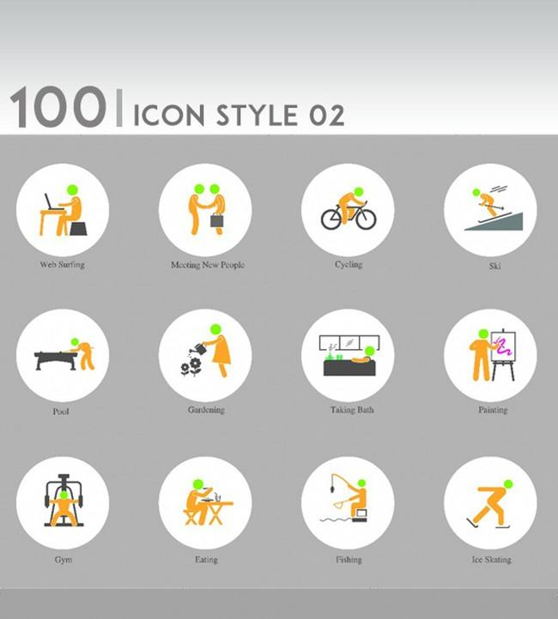
Different people has different hobbies

Slide 3

questions
Why people can develop different hobbies？
What are closely to hobbies? （Family classmates friends）
what did we pay for?（Time money）

Slide 4

The influence of family on the development of hobbies.
Q1: How the family atmosphere influence your hobbies?
Q2: Whether all the family atmosphere is beneficial to developing hobbies?
Q3: What age children are sensitive to family atmosphere?

Slide 5

The way(s) your classmates develop their hobbies.
Q1: What methods your classmates have use to develop hobbies?
Q2: What way do you think is the most useful?
Q3: How long have you insist those methods?

Slide 6

The amount of time / money / effort your classmates spend on their hobbies.
Q1: How do you balance your time between studies and hobbies?
Q2: How much can you pay for your hobbies?
Q3: What the most profound things have you done for your hobbies?

Slide 7
Investigation plan

Slide 8


Using histogram to indicate the comparison
Collect the interviewee’s supportive and negative view then list it

Slide 9

Collect ideas of classmates
Compare the distribution
Using line chart

Slide 10

Using simple histogram to compare
Just list them is okay.

Slide 11

Analyze Investigation

Slide 12

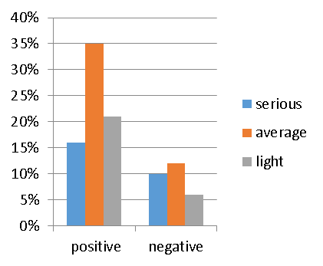
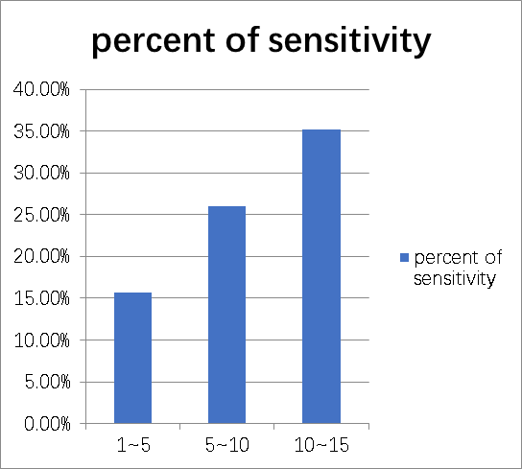
 | serious | average | light
positive | 16% | 35% | 21%
negative | 10% | 12% | 6%
 | percent of sensitivity
1~5 | 15.70%
5~10 | 26%
10~15 | 35.20%

Slide 13

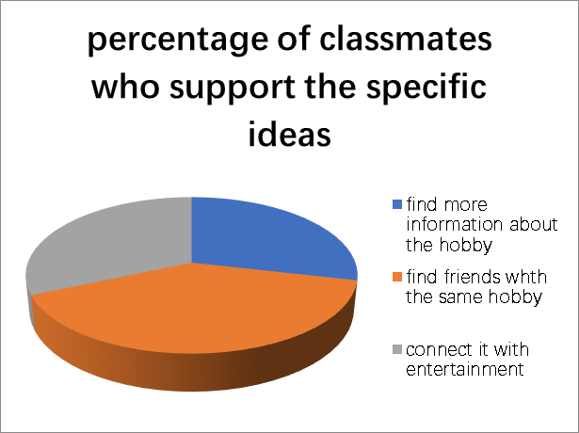
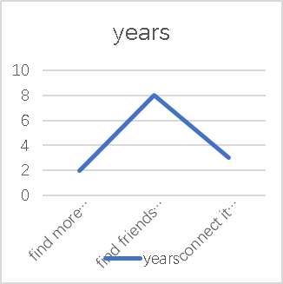
find more information about the hobby | 56.20%
find friends with the same hobby | 78.30%
connect it with entertainment | 62%
 | years
find more information about the hobby | 2
find friends with the same hobby | 8
connect it with entertainment | 3

Slide 14

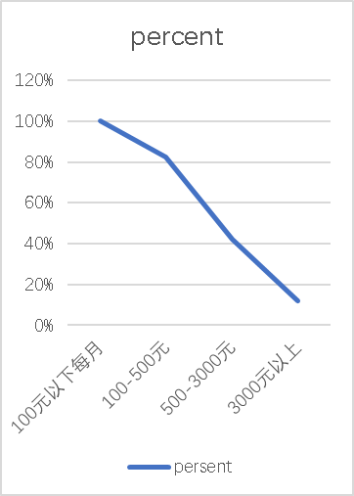
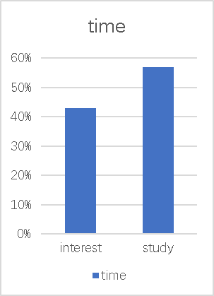
 | time
interest | 43%
study | 57%
 | Percent
100元以下每月 | 100%
100-500元 | 82.30%
500-3000元 | 42.10%
3000元以上 | 12%

Slide 15

summary
Developing their hobbies is the family atmosphere
Change their hobbies to suit surrounding atmosphere
Most people pay less than five handred RMB each month
insist only one hobbies that they are deeply in love.

